Slide 1
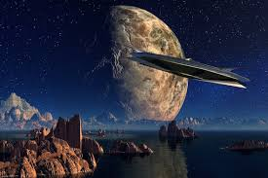
Science fiction (sometimes shortened to sci-fi or SF) is a genre of speculative fiction that typically deals with imaginative and futuristic concepts such as advanced science and technology, space exploration, time travel, parallel universes, and extraterrestrial life.
/Nithya/English/school

Slide 2
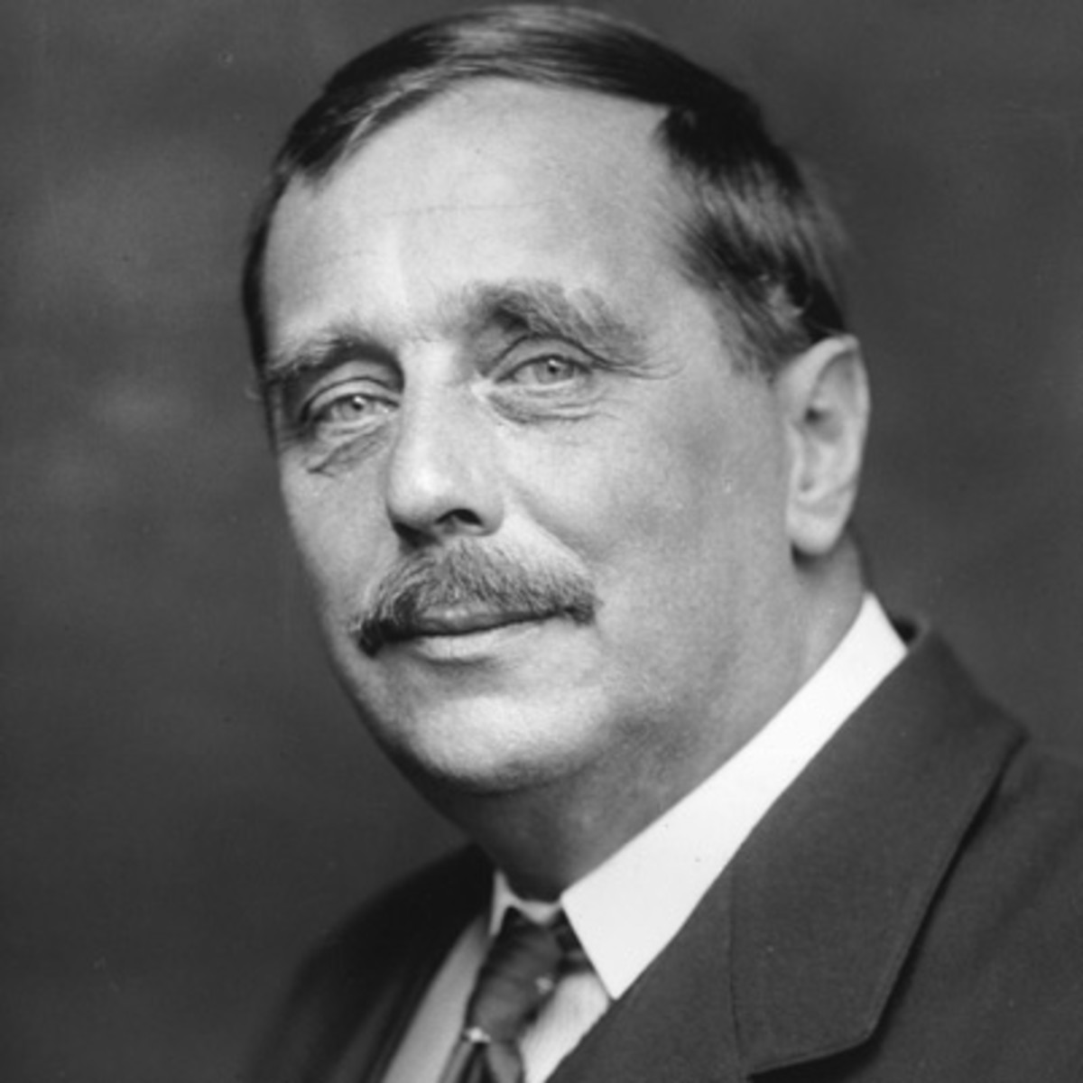
Herbert George Wells was an English writer. Prolific in many genres, he wrote dozens of novels, short stories, and works of social commentary, history, satire, biography and autobiography. His work also included two books on recreational war games. Wikipedia
Born: 21 September 1866, Bromley High Street, London, United Kingdom
Died: 13 August 1946, The Regent's Park, London, United Kingdom
Full name: Herbert George Wells
Movies: Things to Come, The Time Machine, War of the Worlds, MORE
Short stories: The Red Room, The Country of the Blind, The Star, MORE
/Nithya/English/school

Slide 3
Infinitive/Grammar/Nithya/English/school

Slide 9
GOEBBELS

Slide 12
REFERENCES & THANKING SLIDE

